Slide 1
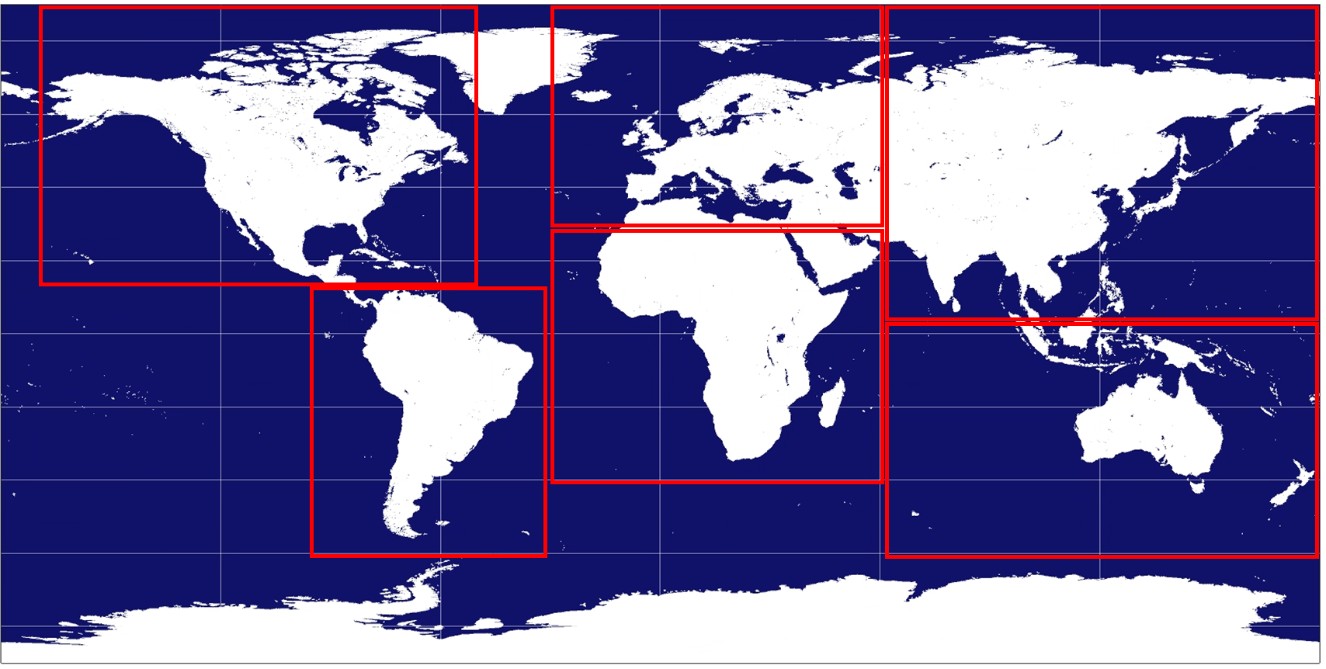
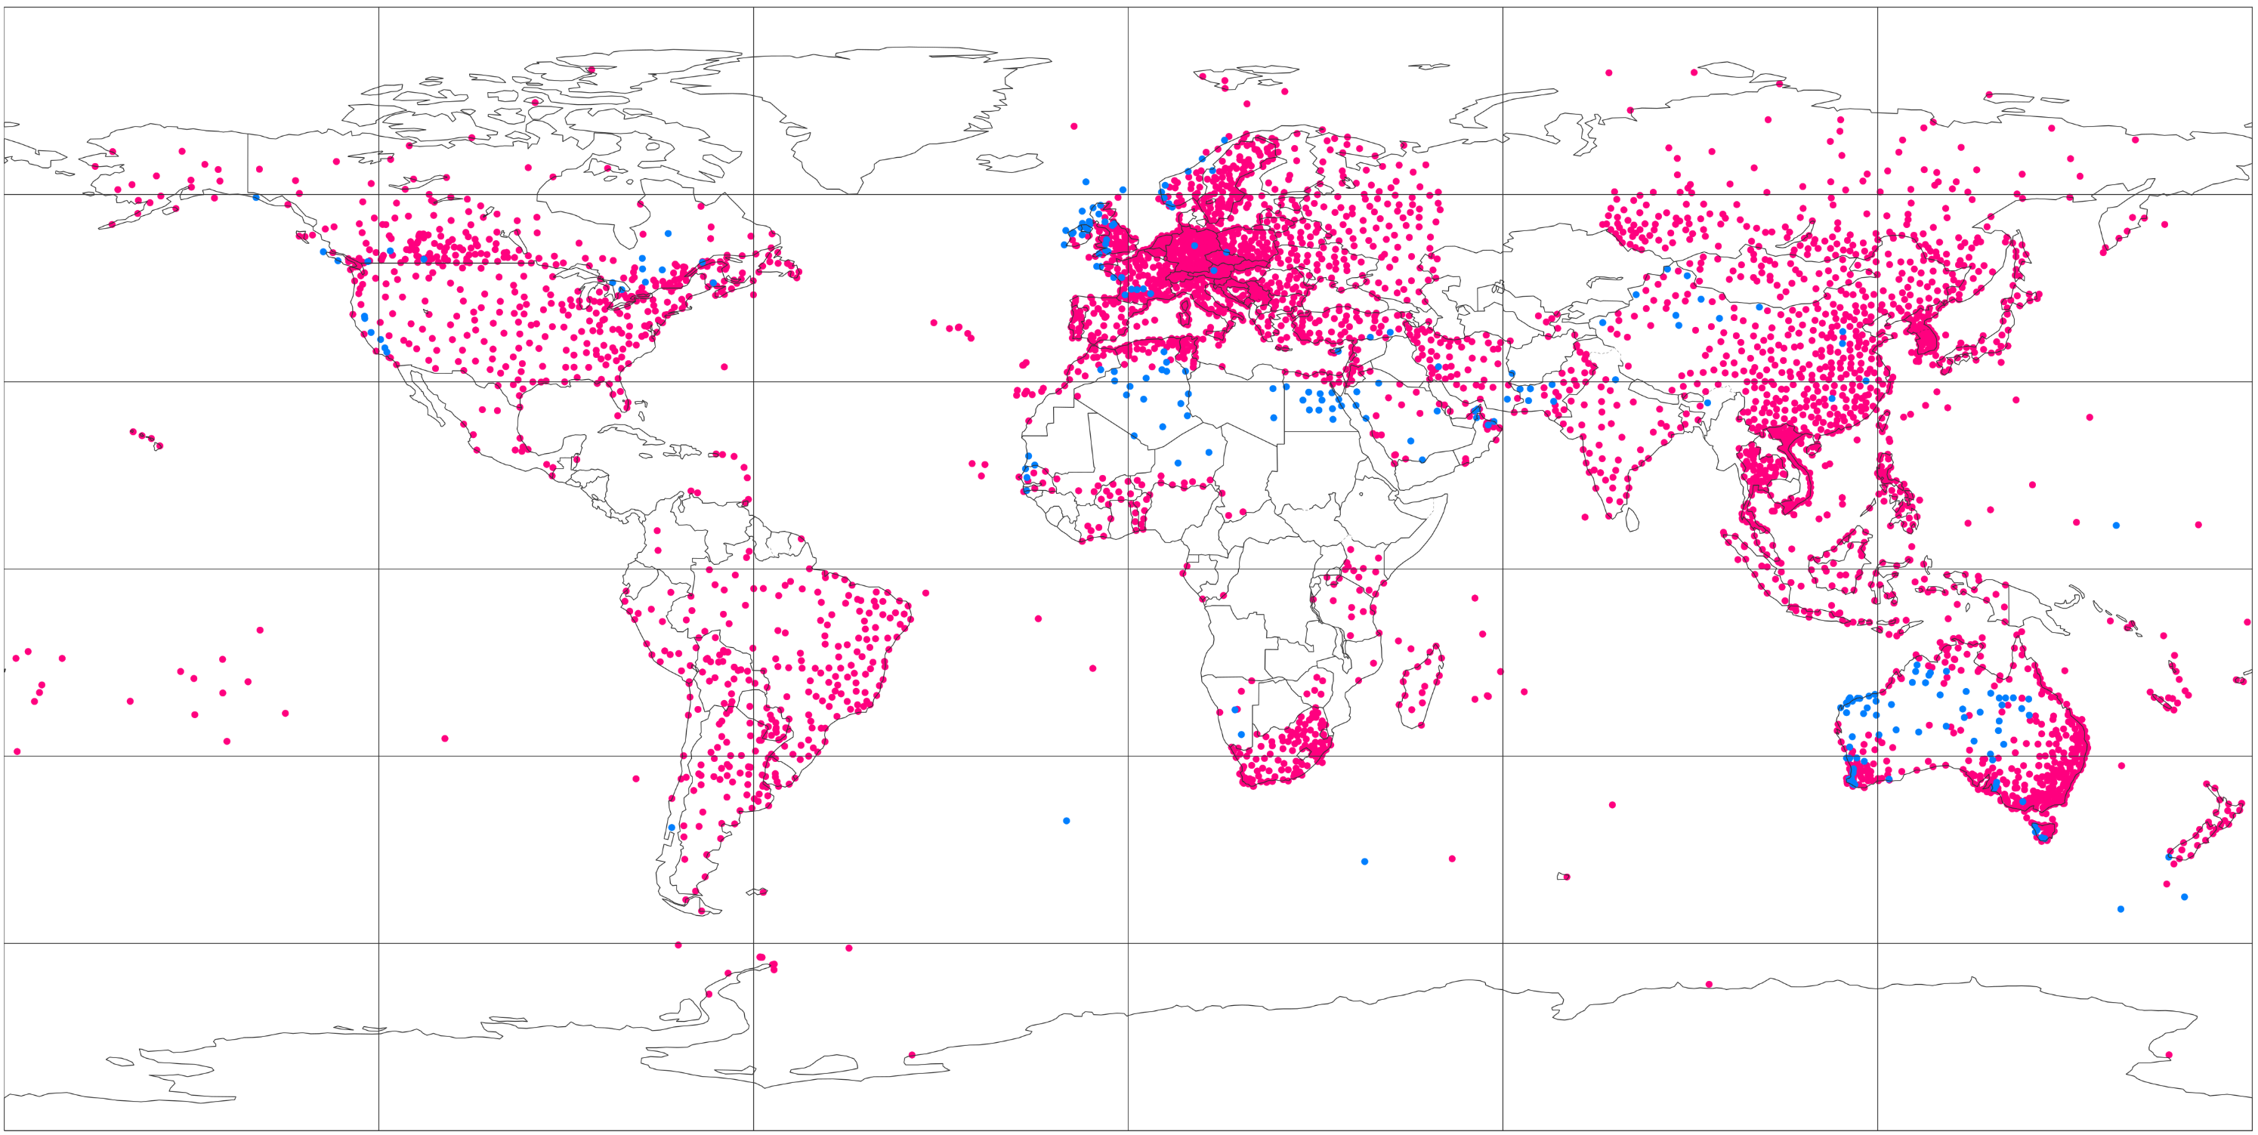
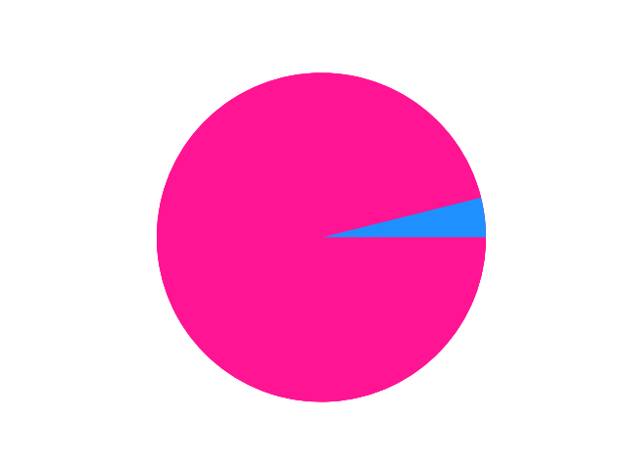
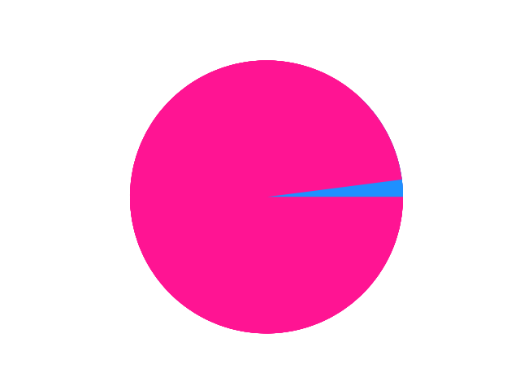
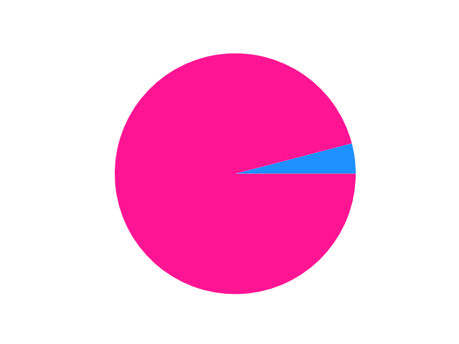
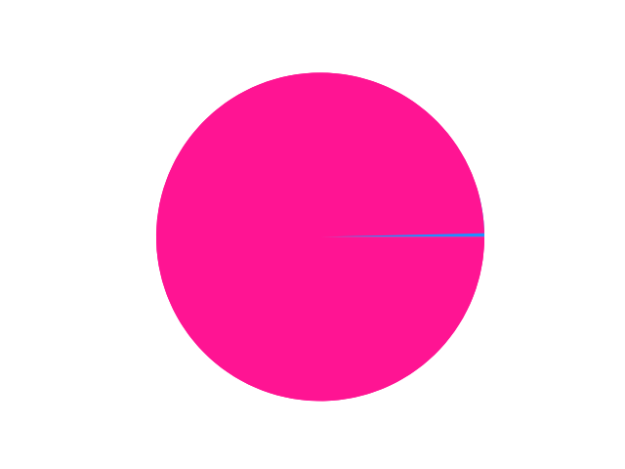


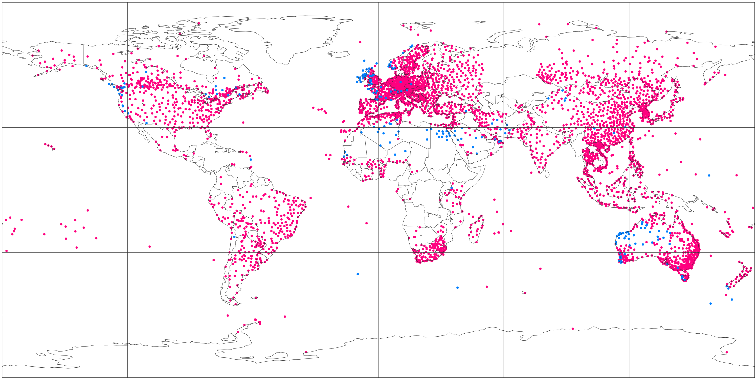


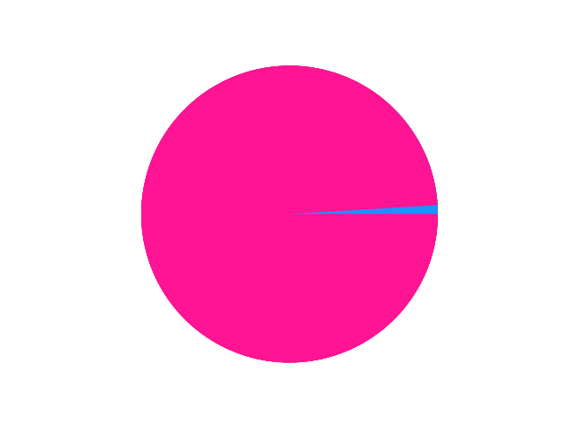




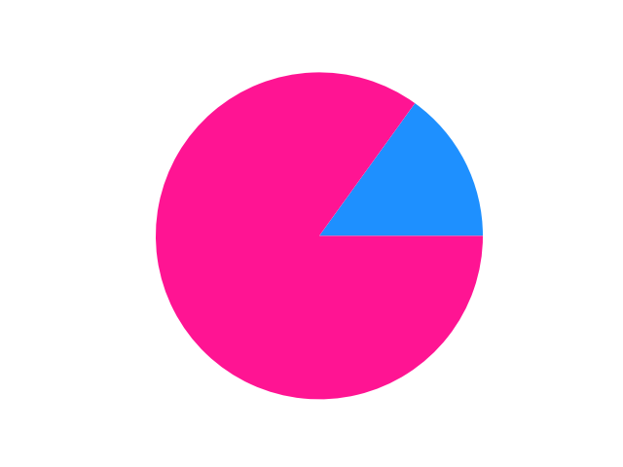



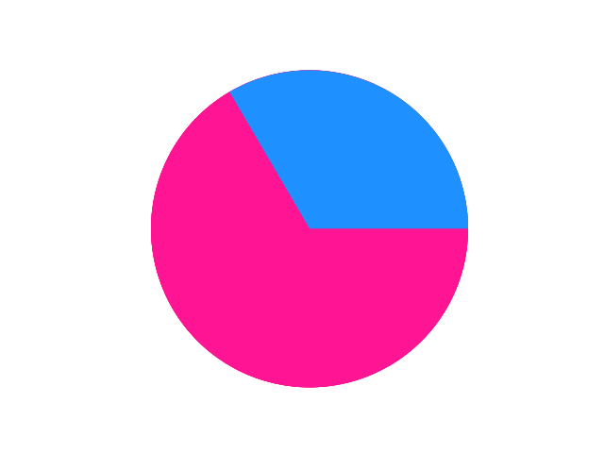
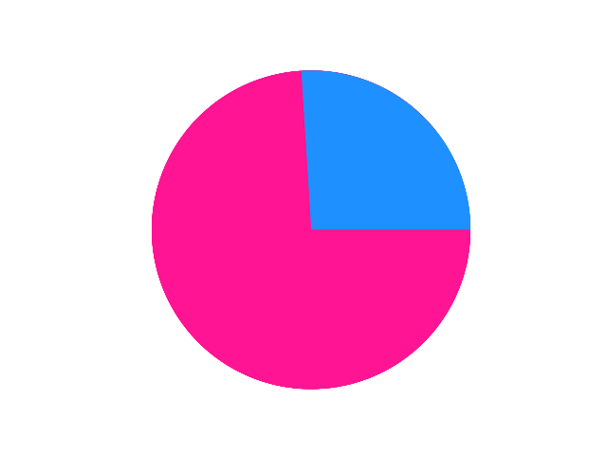
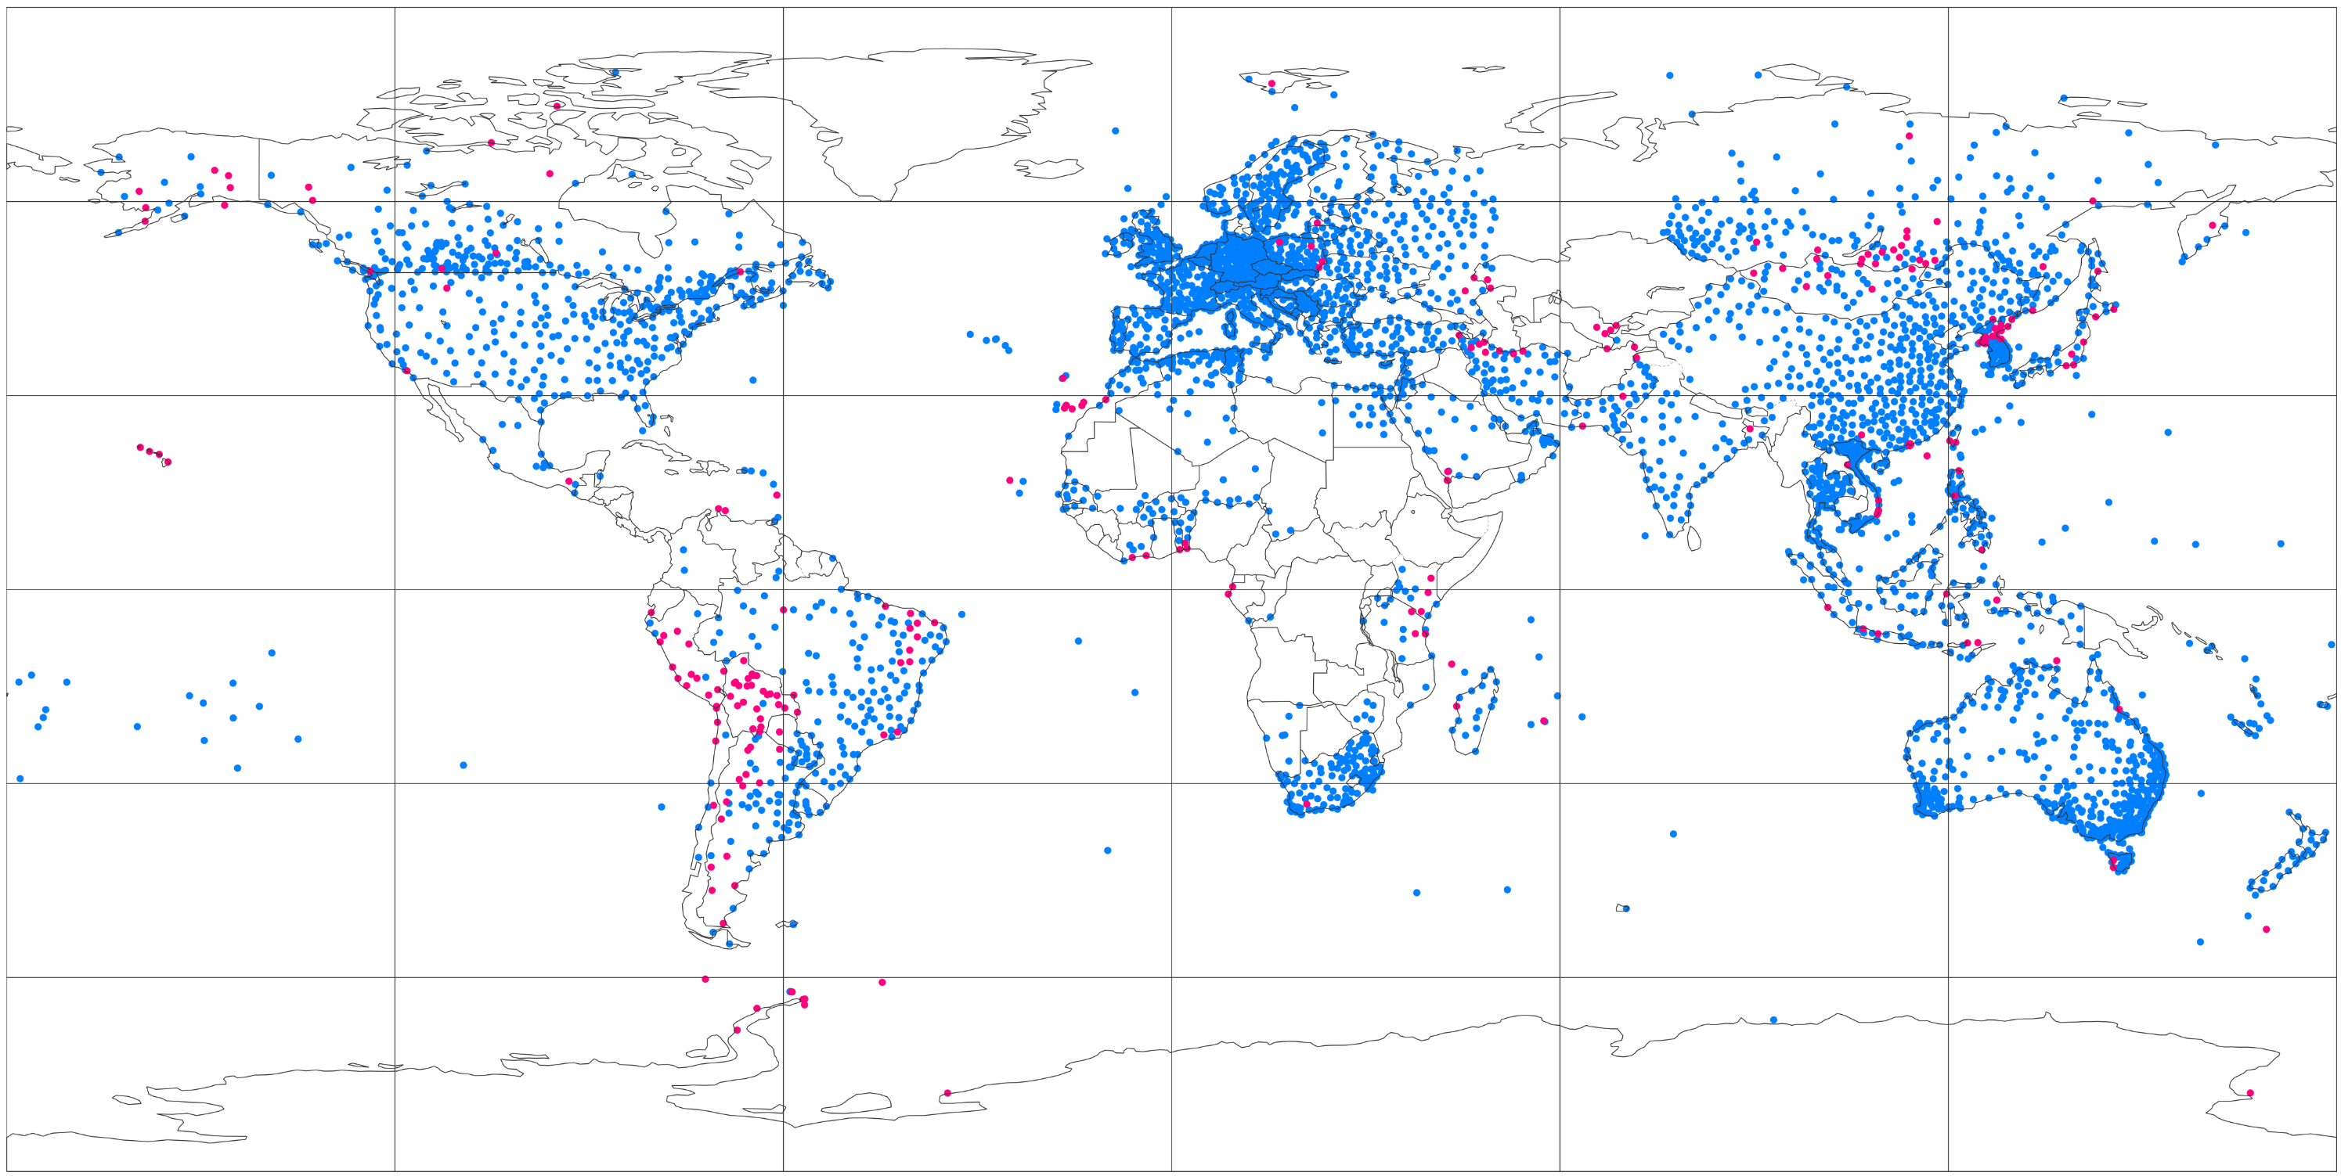
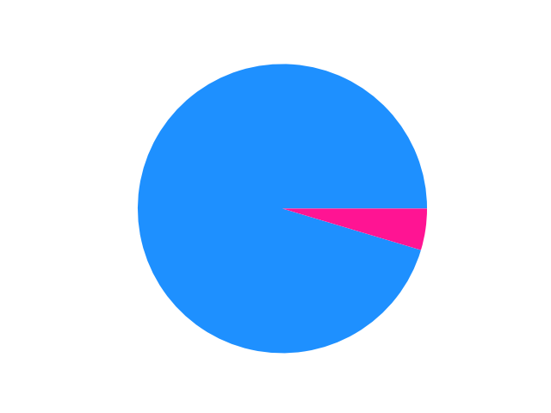
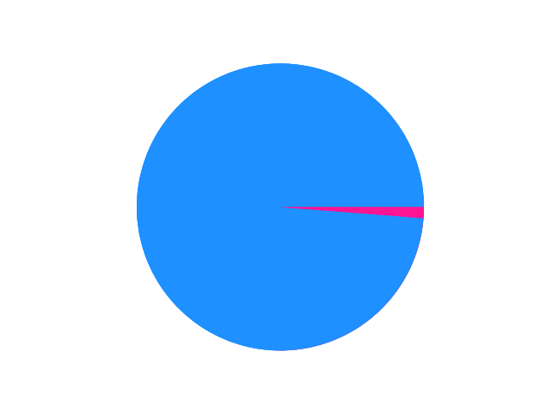
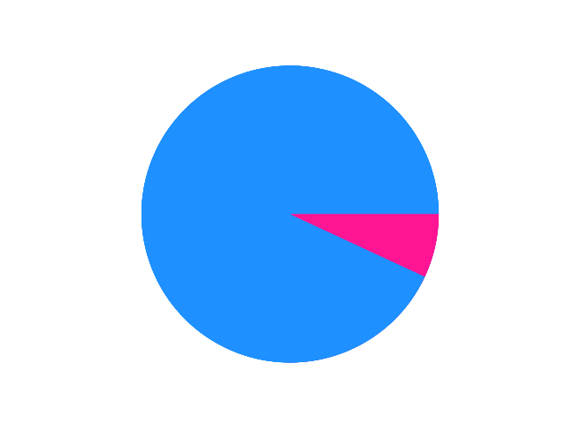
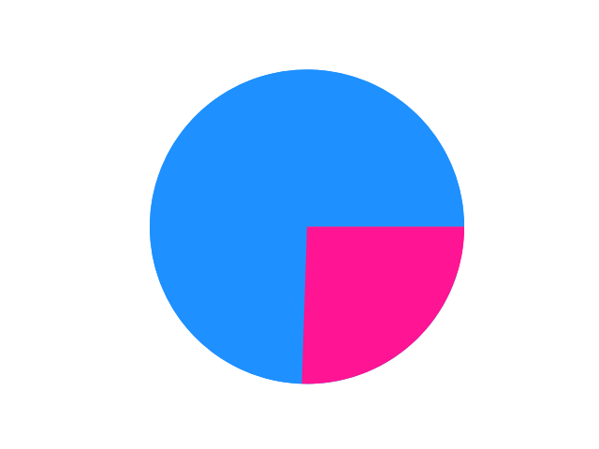

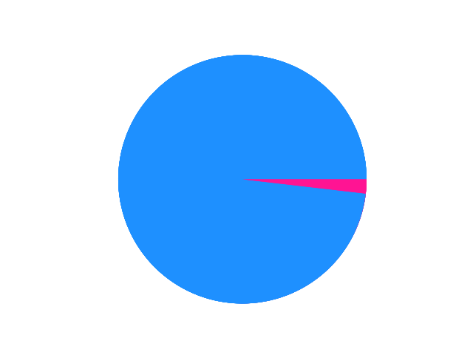
Anderson-Darling (AD) test at 99.99% confidence level
NWP climatology not representative of obs climatology
NWP climatology representative of obs climatology
80 °N
120 °W
60 °W
0 °E
60 °E
120 °E
Asia
[90 °N, 60 °E, 5 °N, 180 °E]
North America
[90 °N, 170 °W, 15 °N, 50 °W]
70 °N
(a) Domains to create the pie-charts
60 °N
Africa & Arabian Peninsula
[30 °N, 30 °W, 40 °S, 60 °E]
Europe & Mediterranean
[90 °N, 30 °W, 30 °N, 60 °E]
30 °N
0 °N
Oceania
[5 °N, 60 °E, 60 °S, 180 °W]
30 °S
South America
[15 °N, 100 °W, 60 °S, 30 °W]
60 °S
80 °S
(b) ERA5 – EDA (62 km)
Domains for pie-charts | % locations Not Representative | % locations Representative
North America | 95.9 % | 4.1 %
South America | 99.7 % | 0.3 %
Europe & Mediterranean | 96.1 % | 3.9 %
Africa & Arabian Peninsula | 87.2 % | 12.8 %
Asia | 98 % | 2 %
Oceania | 89.7 % | 10.3 %
60 °N
30 °N
70 °S
0 °N
30 °S
60 °S
(c) ERA5 (31 km)
Domains for pie-charts | % locations Not Representative | % locations Representative
North America | 94.2 % | 5.8 %
South America | 99.3 % | 0.7 %
Europe & Mediterranean | 95.4% | 4.6 %
Africa & Arabian Peninsula | 87.5 % | 12.5 %
Asia | 99 % | 1 %
Oceania | 91.1 % | 8.9 %
60 °N
30 °N
0 °N
30 °S
60 °S
(d) ECMWF Reforecasts - 46r1 (18 km)
Domains for pie-charts | % locations Not Representative | % locations Representative
North America | 85.1 % | 14.9 %
South America | 99.3 % | 0.7 %
Europe & Mediterranean | 81.7 % | 18.3 %
Africa & Arabian Peninsula | 66.6 % | 33.4 %
Asia | 89.4 % | 10.6 %
Oceania | 74% | 26%
60 °N
30 °N
0 °N
30 °S
60 °S
(e) ERA5–ecPoint (point-scale in 31 km grid)
Domains for pie-charts | % locations Not Representative | % locations Representative
North America | 4.5 % | 95.5 %
South America | 25.7 % | 74.3 %
Europe & Mediterranean | 1.2% | 98.8 %
Africa & Arabian Peninsula | 7.8 % | 92.2 %
Asia | 6.9 % | 93.1 %
Oceania | 1.7 % | 98.3 %
60 °N
30 °N
0 °N
30 °S
60 °S
120 °W
60 °W
0 °E
60 °E
120 °E

